Slide 1
Capstone Project -4
Netflix Movies and Tv Shows Clustering
By
Ishan Singh

Slide 2

Agenda
• Problem Statement
• Data Summary
• Data Cleaning
• Exploratory Data Analysis(EDA)
• Feature Engineering
• Dimensionality Reduction
• Clustering
• Clusters Comparison
• Applications of Clustering
• Challenges Faced
• Conclusion

Slide 3

Abstract
Netflix is a popular subscription-based streaming service and production form. That allows members to watch TV shows and movies. Netflix is one of the world's leading entertainment services with 221 million paid memberships in over 190 countries enjoying TV series, documentaries, feature films and mobile games across a wide variety of genres and languages.

Slide 4
Problem Statement
This dataset consists of tv shows and movies available on Netflix as of 2019. The dataset is collected from Flixable which is a third-party Netflix search engine.In 2018, they released an interesting report which shows that the number of TV shows on Netflix has nearly tripled since 2010. The streaming services number of movies has decreased by more than 2,000 titles since 2010, while its number of TV shows has nearly tripled. It will be interesting to explore what all other insights can be obtained from the same dataset.Integrating this dataset with other external datasets such as IMDB ratings, rotten tomatoes can also provide many interesting findings.
In this project, i have done.
Exploratory Data Analysis
Understanding what type content is available in different countries
Is Netflix has increasingly focusing on TV rather than movies in recent years.
Clustering similar content by matching text-based features

Slide 5
Data Summary
The dataset consists of listings of all the movies and tv shows available on Netflix, and dataset contains 12 columns.
show_id : Unique ID for every Movie / Tv Show
type : Identifier - A Movie or TV Show
title : Title of the Movie / Tv Show
director : Director of the Movie
cast : Actors involved in the movie / show
country : Country where the movie / show was produced
date_added : Date it was added on Netflix
release_year : Actual Release year of the movie / show
rating : TV Rating of the movie / show
duration : Total Duration - in minutes or number of seasons
listed_in : Genre
description: The Summary description

Slide 6
Data Cleaning
•• Handling missing values:
○Director, cast, and country contains 2389,718 and 507 missing values
respectively that is replace with No cast, for country mode imputation and
Director column dropped.
○Date added contains 10 missing values so dropped
○ Rating contains 7 missing values
• The dataset contained separate ratings for movies and tv shows.
• The dataset contained separate age ratings for movies and TV shows, and were
replaced with values of: 'Adults', 'Teens', 'Young Adults', 'Older Kids', 'Kids'.

Slide 7
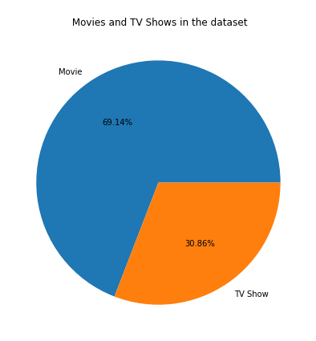
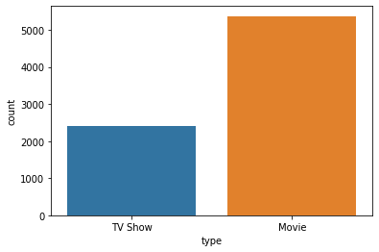
Exploratory Data Analysis (EDA)
● Netflix has 5372 movies and 2398 TV shows,there are more number movies on Netflix than TV shows. Means,69.14% of the shows on Netflix are movies, and 30.86% TV shows.

Slide 8
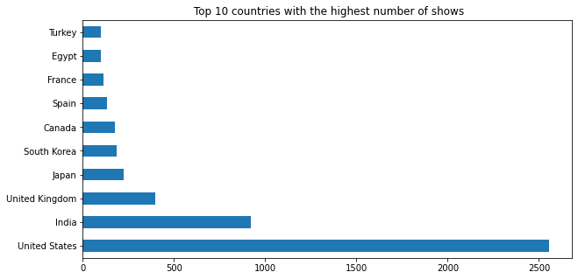
EDA(contd,)
● The top 3 countries together account for about 56% of all movies and TV shows in the dataset.
● This value increases to about 78% for top ten countries.

Slide 9
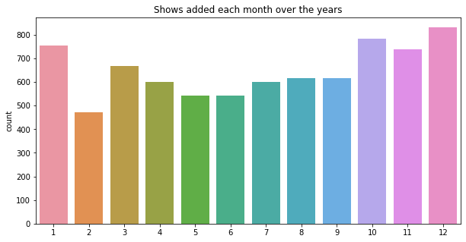
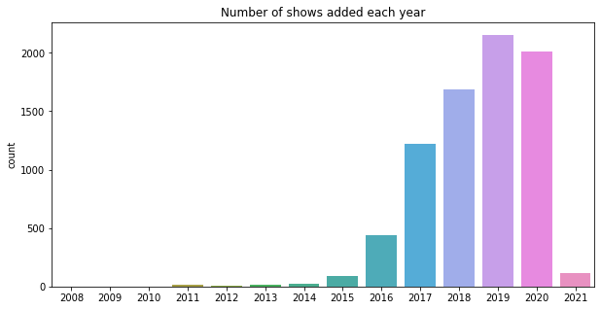
EDA(CONTD,)
● More shows are added in the months of October, November, December, and January.
● There is a decrease in the number of shows added in the year 2020.
● There are very few shows added in the year 2021, since the data is available only up to 16th January.

Slide 10
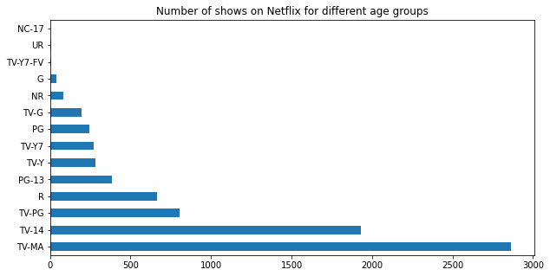
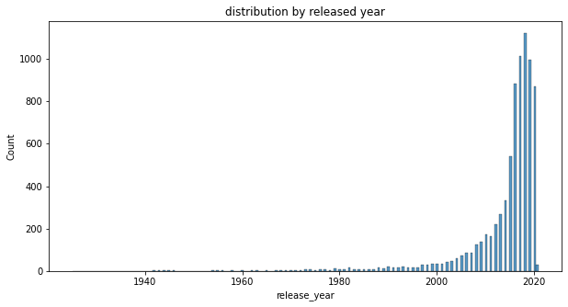
EDA(CONTD,)
● The majority of the shows on Netflix are catered to TV-MA and TV-14 that is for adults and young adults.
● Netflix has greater number of new movies / TV shows than the old ones.

Slide 11
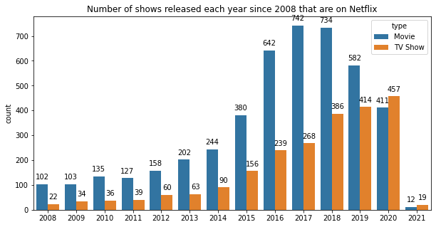
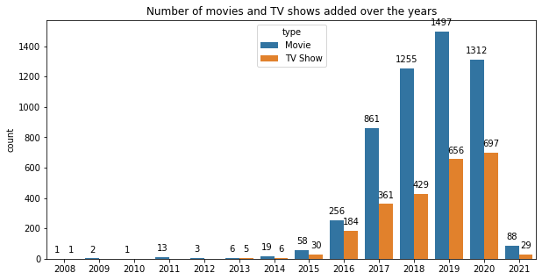
EDA(CONTD,)
● Though there was a decrease in the number of movies added in 2020, this pattern did not exist in the number of TV shows added in the same year.
● This might sign that Netflix is increasingly concentrating on introducing more TV series to its platform rather than movies.

Slide 12
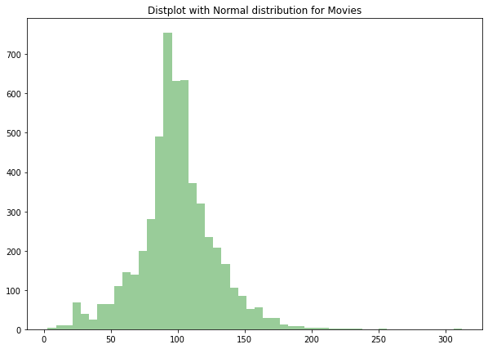
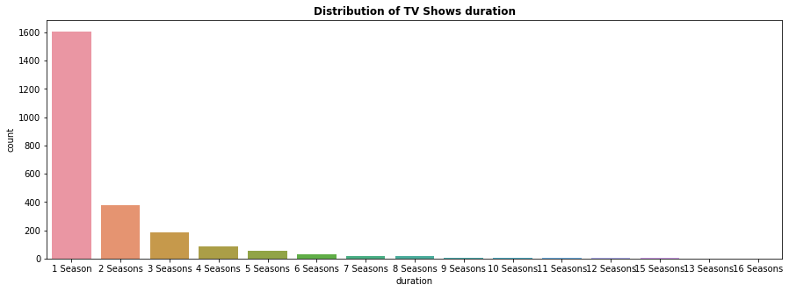
EDA(CONTD,)
● The length of movies in the are almost normally distributed.
● Most of the movies have duration of between 50 to 150
● Majority of the TV shows are still in the 1 st season.

Slide 13
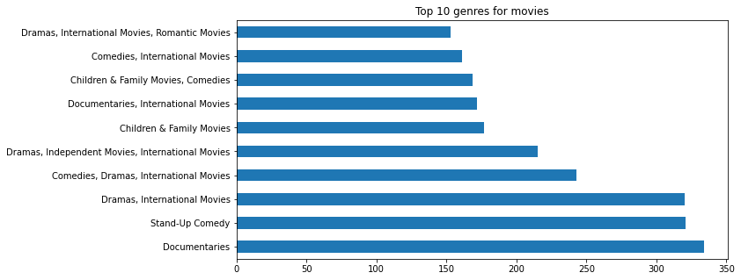
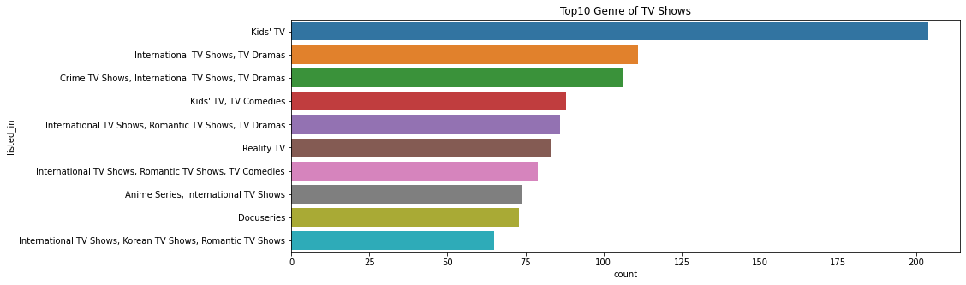
EDA(CONTD,)
● Dramas, comedies, and documentaries are the most popular genre for the movies on Netflix.
● International, crime, and kids are the most popular genre for TV shows on Netflix.

Slide 14
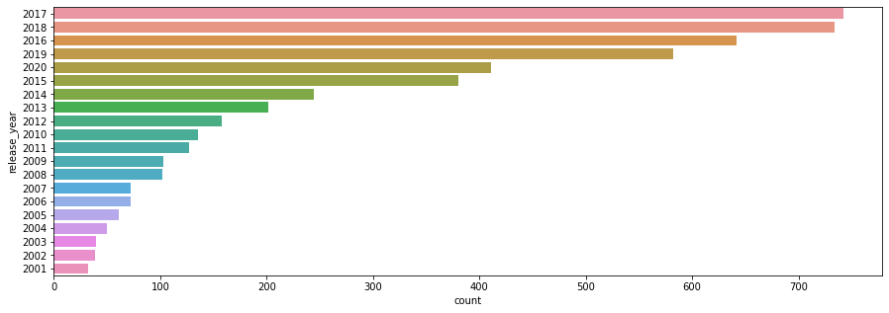
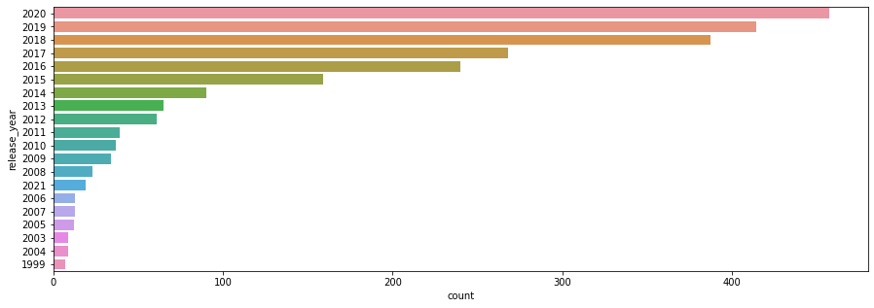
EDA(CONTD,)
● In the last 20 years highest number of movies released in 2017 and 2018
● In the last 15 years highest number of movies released in 2020
● The number of movies on Netflix is growing significantly faster than the number of TV shows.
● We can see that increase in the number of movies and television episodes after 2015.
● It appears that Netflix has focused more attention on increasing Movie content that TV Shows. Movies have increased much more dramatically than TV shows.

Slide 15
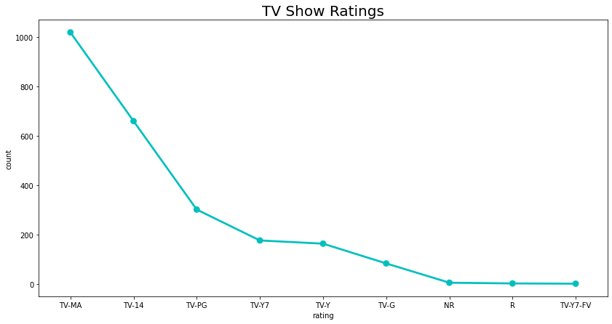
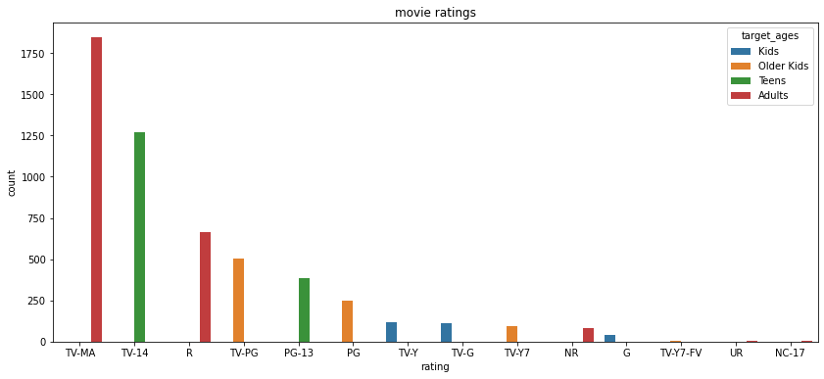
EDA(CONTD,)
● TV-MA has the highest number of ratings for tv shows i,e adult ratings
● TV-MA has the highest number of ratings for movies i,e adult ratings
● In both the cases we can see that TV-MA has the highest number of ratings followed by TV-14

Slide 16
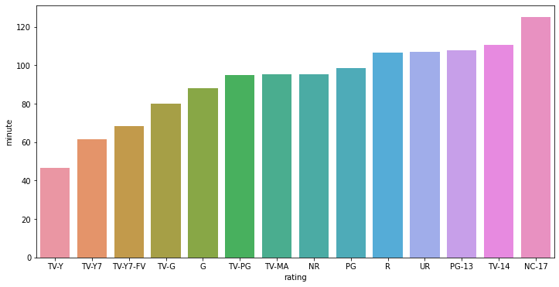
EDA(CONTD,)
● Those movies that have a rating of NC-17 (i.e. Adults) have the highest duration. Where as TV-Y(i.e.kids) have the lowest duration.

Slide 17
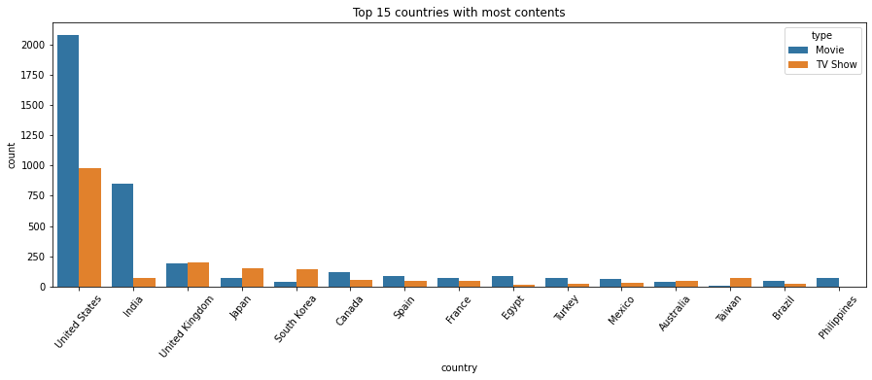
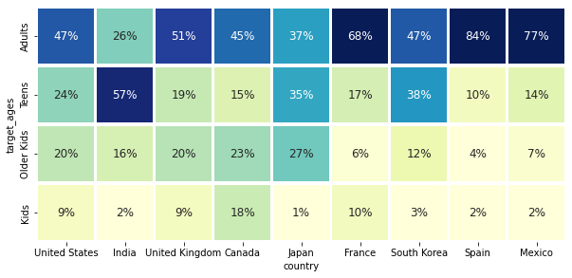
EDA(CONTD,)
● United States has the highest number of content on the netflix ,followed by India
● India has highest number of movies in netflix and very low of Tv shows
● The US and UK are closely aligned with their Netflix target ages, but radically different from India or Japan!
● Also, Mexico and Spain have similar content on Netflix for different age groups.

Slide 18
Feature Engineering
● Clusters are built based on the attributes: Director, Cast, Country, Rating, Listed in (genres), and Description
● Steps involved in data pre-processing:
1. Tokenization
2. Removing non-ascii characters
3. Converting to lowercase
4. Removing punctuation marks
5. Replacing numbers with its respective textual
representation.

Slide 19
Feature Engineering(contd,)
● TFIDF (Term Frequency Inverse Document Frequency) vectorizer was used to vectorize the corpus.
𝑇𝐹 = Number of times term t appears in a document /Total number of terms in the document
𝐼𝐷𝐹 = log𝑒 (Total number of documents/ Number of documents with term t in it) 𝑇𝐹𝐼𝐷𝐹 = 𝑇𝐹 × 𝐼𝐷𝐹
● Maximum number of features were taken as 20000.

Slide 20
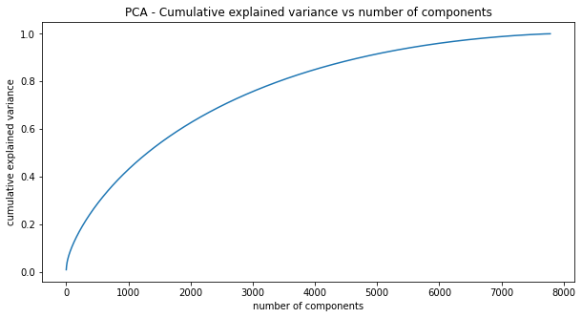
Dimensionality Reduction
● 100% of the variance in data is explained by about 7500 components.
● To reduce dimensionality, only the top 4000 components were taken, which will still be able to capture more than 80% of variance in the data.

Slide 21
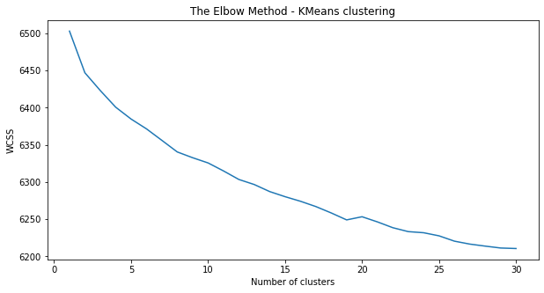
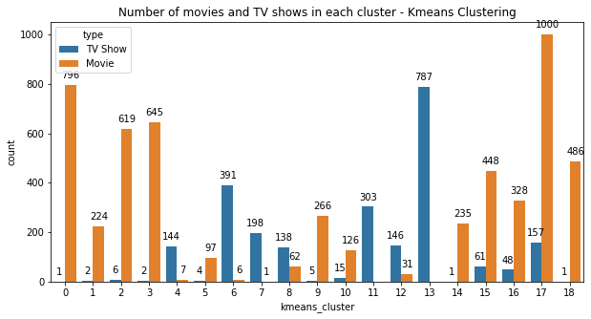
K-means clustering
● K-Means Clustering is an Unsupervised Learning algorithm which groups the unlabeled dataset into different clusters. Here K defines the number of predefined clusters that need to be created in the process, as if K=2, there will be two clusters, and for K=3, there will be three clusters, and so on.
● Distortion: 6249.0766
● Silhouette score: 0.0070
● Number of clusters: 19
● cluster 17 has the highest number of datapoints and evenly distributed for other cluster

Slide 22
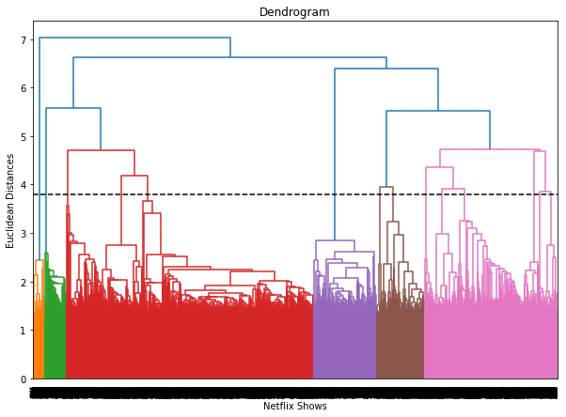
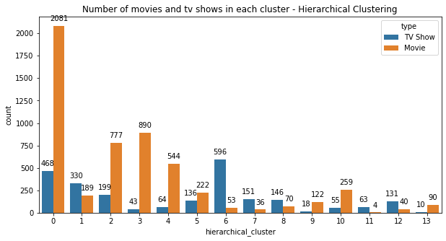
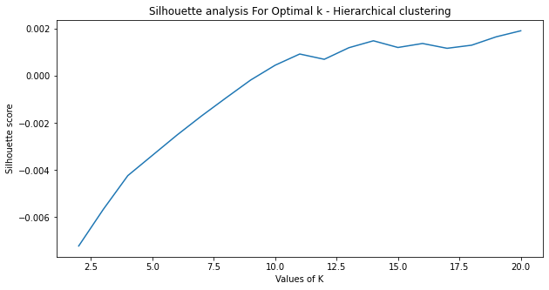
Hierarchical Clustering
● In agglomerative clustering no need to give the value of k beforehand.The agglomerative hierarchical clustering algorithm is a popular example of HCA. Here I used ward linkage and the optimal number of clusters is 7 using the Dendrogram.
● Distance: Euclidean
● Linkage: Ward
● Silhouette score: 0.0014
● Number of clusters: 14

Slide 23
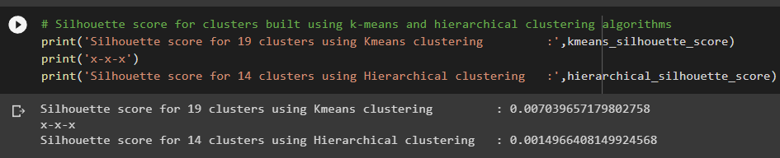
Clusters Comparison
● Since the Silhouette score obtained by the hierarchical clustering algorithm is lower than that of K means clustering algorithm, we can say that the k means clustering algorithm does a better job in clustering the dataset.

Slide 24
Application of Clustering
● We can build a simple content-based recommender system using the constrained k-means clustering algorithm.
● The k-means constrained clustering algorithm works similar to the k-means clustering algorithm, except that, we can specify the maximum and minimum elements in each cluster.

Slide 25
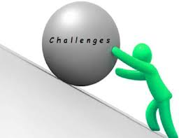
Challenges Faced
● Deciding the attributes on which we can build the clusters
● Feature engineering – deciding on the features to be dropped/kept/transformed
● Choosing the best visualization to show the trends clearly in the EDA phase
● Deciding on ways to handle the missing values
● Deciding on the attributes to be considered for clustering the dataset
● High computation time

Slide 26
Conclusions
● In the project we worked on text clustering problem where in we had to cluster the Netflix shows such that the shows within a cluster are similar to each other and the shows in different clusters are dissimilar to each other.
● The dataset contained about 7787 records, and 11 attributes.
● We began by dealing with the dataset missing values and doing exploratory data analysis (EDA).
● It was found that Netflix hosts more movies than TV shows on its platform, and the total number of shows added on Netflix is growing exponentially. Also, majority of the shows were produced in the United States, and the majority of the shows on Netflix were created for adults and young adults age group.
● It was decided to cluster the data based on the attributes: director, cast, country, rating, genre, and description. The values in these attributes were tokenized, pre-processed, and then vectorized using TFIDF vectorizer.

Slide 27
Conclusions(contd,)
● Through TFIDF Vectorization, we created a total of 20000 attributes.
● We used Principal Component Analysis (PCA) to handle the curse of dimensionality. 4000 components were able to capture more than 80% of variance, and hence, the number of components were restricted to 4000.
● We first built clusters using the k-means clustering algorithm, and the optimal number of clusters came out to be 19. This was obtained through the elbow method and Silhouette score analysis.
● Hierarchical clustering model was built using the Agglomerative clustering algorithm, and the optimal number of clusters came out to be 14. This was obtained after visualizing the dendogram, and Silhouette score analysis.
● The k means clustering algorithm does a better job in clustering the shows than hierarchical clustering algorithm.

Slide 28
Thank You!

